Slide 1
Distributed Databases

Slide 2
Concepts
Distributed Database.
  A logically interrelated collection of shared data (and a description of this data), physically distributed over a computer network.
Distributed DBMS.
  Software system that permits the management of the distributed database and makes the distribution transparent to users.
Notes:
September 98
3
Chapter Name

Slide 3
Concepts
Collection of logically-related shared data.
Data split into fragments.
Fragments may be replicated.
Fragments/replicas allocated to sites.
Sites linked by a communications network.
Data at each site is under control of a DBMS.
DBMSs handle local applications autonomously.
Each DBMS participates in at least one global application.
Notes:
September 98
4
Chapter Name

Slide 4
Reason for Data Distribution
Centralized DBMS vs. Distributed Database System
A distributed database is a collection of data that belongs logically to the same system but is physically spread over the sites of a computer network
Several factors have led to the development of DDBS:
  Distributed nature of some database applications
  Increased reliability and availability
  Allowing data sharing while maintaining some measure of local control
  Improved performance

Slide 5
Component Architecture for a DDBMS
site 1
GDD
DDBMS
DC
LDBMS
GDD
Computer Network
DDBMS
DC
site 2
DB
LDBMS : Local DBMS component
DC : Data communication component
GDD : Global Data Dictionary

Slide 6
The Ideal Situation
A single application should be able to operate transparently on data that is:
  spread across a variety of different DBMS's
  running on a variety of different machines
  supported by a variety of different operating systems
  connected together by a variety of different communication networks
The distribution can be geographical or local

Slide 7
Workable definition
A distributed database system consists of a collection of sites connected together via some kind of communications network, in which :
  each site is a database system site in its own right;
  the sites agree to work together, so that a user at any site can access data anywhere in the network exactly as if the data were all stored at the user's own site
It is a logical union of real databases
It can be seen as a kind of partnership among individual local DBMS's
Difference with remote access or distributed processing systems
Temporary assumption: strict homogeneity

Slide 8
Additional Functionality of DDBS
Distribution leads to increased complexity in the system design and implementation
DDBMS must be able to provide additional functions to those of a centralized DBMS. Some of these are:
  To access remote sites and transmit queries and data among the various sites via a communication network.
  To keep track of the data distribution and replication in the DDBMS catalog.
  To devise execution strategies for queries and transactions that access data from more than one site.
  To decide on which copy of a replicated data item to access.
  To maintain the consistency of copies of a replicated data item.
  To maintain the global conceptual schema of the distributed database
  To recover from individual site crashes and from new types of failures such as failure of a communication link.

Slide 9
Types of DDBMS
In a homogeneous distributed database
  All sites have identical software
  Are aware of each other and agree to cooperate in processing user requests.
  Each site surrenders part of its autonomy in terms of right to change schemas or software
  Appears to user as a single system
In a heterogeneous distributed database
  Different sites may use different schemas and software
    Difference in schema is a major problem for query processing
    Difference in software is a major problem for transaction processing
  Sites may not be aware of each other and may provide only limited facilities for cooperation in transaction processing

Slide 10
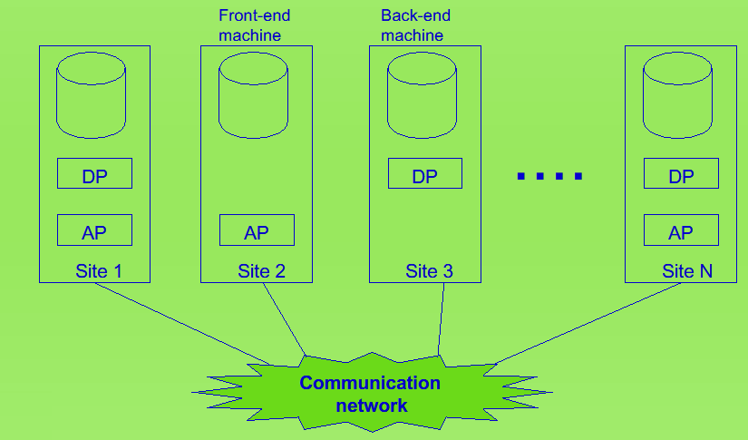
Physical Architecture of DDBS

Slide 11
Distributed Database Design
Fragmentation
  Relation may be divided into a number of sub-relations, which are then distributed.
Allocation
  Each fragment is stored at site with "optimal" distribution.
Replication
  Copy of fragment may be maintained at several sites.
Notes:
September 98
27
Chapter Name

Slide 12
Fragmentation
Definition and allocation of fragments carried out strategically to achieve:
  Locality of Reference
  Improved Reliability and Availability
  Improved Performance
  Balanced Storage Capacities and Costs
  Minimal Communication Costs.
Involves analyzing most important applications, based on quantitative/qualitative information.
Notes:
September 98
28
Chapter Name

Slide 13
Fragmentation
Quantitative information may include:
  frequency with which an application is run;
  site from which an application is run;
  performance criteria for transactions and applications.
Qualitative information may include transactions that are executed by application, type of access (read or write), and predicates of read operations.
Notes:
September 98
29
Chapter Name

Slide 14
Data Allocation
Four alternative strategies regarding placement of data:
  Centralized
  Partitioned (or Fragmented)
  Complete Replication
  Selective Replication
Notes:
September 98
30
Chapter Name

Slide 15
Data Allocation
Centralized
  Consists of single database and DBMS stored at one site with users distributed across the network.
Partitioned
  Database partitioned into disjoint fragments, each fragment assigned to one site.
Notes:
September 98
31
Chapter Name

Slide 16
Data Allocation
Complete Replication
  Consists of maintaining complete copy of database at each site.
Selective Replication
  Combination of partitioning, replication, and centralization.
Notes:
September 98
32
Chapter Name

Slide 17
Why Fragment?
Usage
  Applications work with views rather than entire relations.
Efficiency
  Data is stored close to where it is most frequently used.
  Data that is not needed by local applications is not stored.
Notes:
September 98
34
Chapter Name

Slide 18
Why Fragment?
Parallelism
  With fragments as unit of distribution, transaction can be divided into several subqueries that operate on fragments.
Security
  Data not required by local applications is not stored and so not available to unauthorized users.
Disadvantages
  Performance
  Integrity.
Notes:
September 98
35
Chapter Name

Slide 19
Correctness of Fragmentation
Three correctness rules:
  Completeness
  Reconstruction
  Disjointness.
Notes:
September 98
37
Chapter Name

Slide 20
Correctness of Fragmentation
Completeness
  If relation R is decomposed into fragments R1, R2, ... Rn, each data item that can be found in R must appear in at least one fragment.
Reconstruction
  Must be possible to define a relational operation that will reconstruct R from the fragments.
  Reconstruction for horizontal fragmentation is Union operation and Join for vertical .
Notes:
September 98
38
Chapter Name

Slide 21
Correctness of Fragmentation
Disjointness
  If data item di appears in fragment Ri, then it should not appear in any other fragment.
  Exception: vertical fragmentation, where primary key attributes must be repeated to allow reconstruction.
  For horizontal fragmentation, data item is a tuple
  For vertical fragmentation, data item is an attribute.
Notes:
September 98
39
Chapter Name

Slide 22
Types of Fragmentation
Four types of fragmentation:
  Horizontal
  Vertical
  Mixed
  Derived.
Other possibility is no fragmentation:
  If relation is small and not updated frequently, may be better not to fragment relation.
Notes:
September 98
40
Chapter Name

Slide 23
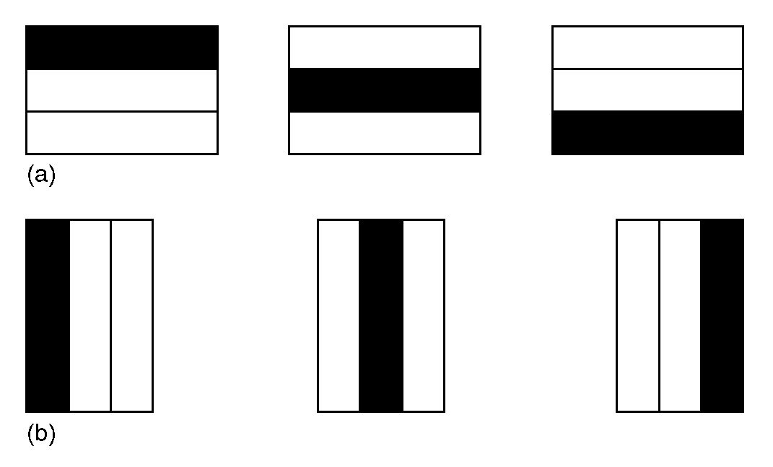
Horizontal and Vertical Fragmentation
41
Notes:
September 98
41
Chapter Name

Slide 24
Horizontal Fragmentation
This strategy is determined by looking at predicates used by transactions.
Involves finding set of minimal (complete and relevant) predicates.
Set of predicates is complete, if and only if, any two tuples in same fragment are referenced with same probability by any application.
Predicate is relevant if there is at least one application that accesses fragments differently.
Notes:
September 98
44
Chapter Name

Slide 25
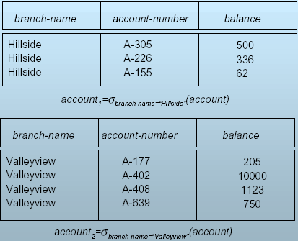
Horizontal Fragmentation of account Relation
Notes:
Selection of all account details for branch-name=….for rows

Slide 26
Vertical Fragmentation
Vertical fragmentation: the schema for relation r is split into several smaller schemas
  All schemas must contain a common candidate key (or superkey) to ensure lossless join property.
  A special attribute, the tuple-id attribute may be added to each schema to serve as a candidate key.
Example : relation account with following schema
Account-schema = (branch-name, account-number, balance)

Slide 27
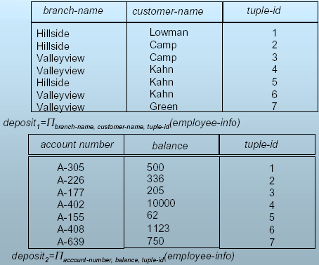
Vertical Fragmentation of employee info Relation
Notes:
This is a projection operator used to produce from a relation a new relation

Slide 28
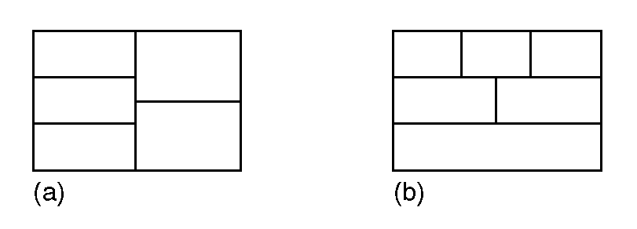
Mixed Fragmentation
Notes:
September 98
42
Chapter Name

Slide 29
Advantages of Fragmentation
Horizontal:
  allows parallel processing on fragments of a relation
  allows a relation to be split so that tuples are located where they are most frequently accessed
Vertical:
  allows tuples to be split so that each part of the tuple is stored where it is most frequently accessed
  tuple-id attribute allows efficient joining of vertical fragments
  allows parallel processing on a relation
Vertical and horizontal fragmentation can be mixed.
  Fragments may be successively fragmented to an arbitrary depth.

Slide 30
Data Replication (1)
A relation or fragment of a relation is replicated if it is stored redundantly in two or more sites.
Full replication of a relation is the case where the relation is stored at all sites.
Fully redundant databases are those in which every site contains a copy of the entire database.

Slide 31
Data Replication (2)
Advantages of Replication
  Availability: failure of site containing relation r does not result in unavailability of r is replicas exist.
  Parallelism: queries on r may be processed by several nodes in parallel.
  Reduced data transfer: relation r is available locally at each site containing a replica of r.
Disadvantages of Replication
  Increased cost of updates: each replica of relation r must be updated.
  Increased complexity of concurrency control: concurrent updates to distinct replicas may lead to inconsistent data unless special concurrency control mechanisms are implemented.
    One solution: choose one copy as primary copy and apply concurrency control operations on primary copy

Slide 32
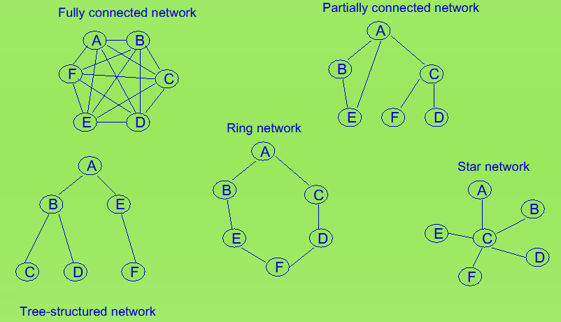
Possible Network Topologies

Slide 33
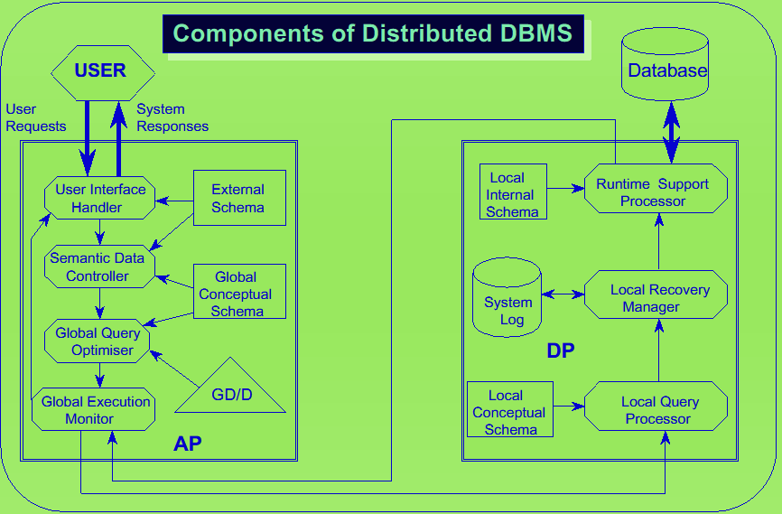

Slide 34
Date’s 12 Rules for Distributed Systems
Local autonomy
No reliance on a central site
Continuous operation
Location independence
Fragmentation independence
Replication independence
Distributed query processing
Distributed transaction management
Hardware independence
Operating system independence
Network independence
DBMS independence
Rule 0. Fundamental Principle:
TO THE USER, A DISTRIBUTED SYSTEM SHOULD LOOK EXACTLY LIKE A NONDISTRIBUTED SYSTEM

Slide 35
Rule 1 : Local Autonomy
Local data is locally owned and managed, with local accountability
  security considerations
  integrity considerations
Local operations remain purely local
All operations at a given site are controlled by that site; no site X should depend on some other site Y for its successful functioning
In some situations some slight loss of autonomy is inevitable
  fragmentation problem - Rule 5
  replication problem - Rule 6
  update of replicated relation - Rule 6
  multiple-site integrity constraint problem - Rule 7
  a problem of participation in a two-phase commit process - Rule 8
Autonomy objective: Sites should be autonomous to the maximum extent possible

Slide 36
Rule 2 : No Reliance on a Central Site
There must not be any reliance on a central “master” site for some central service, such as centralized query processing or centralized transaction management, such that the entire system is dependent on that central site
Reliance on a central site would be undesirable for at least the following two reasons:
  that central site might be a bottleneck
  the system would be vulnerable
In a distributed system, therefore, the following functions (among others) must all be distributed:
  Dictionary management
  Query processing
  Concurrency control
  Recovery control

Slide 37
Rule 3 : Continuous Operation
There should ideally never be any need for a planned entire system shutdown
Incorporating a new site X into an existing distributed system not bring the entire system to a halt
Incorporating a new site X into an existing distributed system not require any changes to existing user programs or terminal
Removing an existing site X from the distributed system should cause any unnecessary interruptions in service
Within the distributed system, it should be possible to create destroy fragments and replicas of fragments dynamically
It should be possible to upgrade the DBMS at any given component to a newer release without taking the entire system down

Slide 38
Rule 4 : Location Independence (Transparency)
Users should not have to know where data is physically stored, but rather should be able to behave - at least from a logical standpoint - as if the data was all stored at their own local site
Simplifies user programs and terminal activities
Allows data to migrate from site to site
It is easier to provide location independence for simple retrieval
operations than it is for update operations
Distributed data naming scheme and corresponding support from
the dictionary subsystem
User naming scheme
  User U has to have a valid logon ID at each of multiple sites to operate
  User profile for each valid logon ID in the dictionary
  Granting of access privileges at each component site

Slide 39
Rule 5 : Fragmentation Independence
A distributed system supports data fragmentation if a given relation can be divided up into pieces or “fragments” for physical storage purposes
A system that supports data fragmentation should also support fragmentation independence (also known as fragmentation transparency)
Users should be able to behave (at least from a logical standpoint) as if the data were in fact not fragmented at all
Fragmentation is desirable for performance reasons
Horizontal fragmentation → SELECT
Vertical fragmentation → PROJECT
Fragmentation must be defined within the context of a distributed database
o Fragmentation independence (like location independence) is desirable because it simplifies user programs and terminal activities
Fragmentation independence implies that users should normally be presented with a view of the data in which the fragments are logically combined together by means of suitable joins and unions

Slide 40
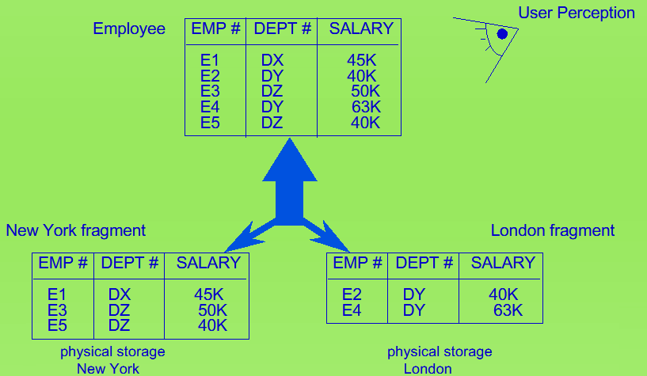
Rule 5 : An Example of Fragmentation

Slide 41
Rule 6 : Replication Independence (Transparency)
User should be able to behave as if the data were in fact not replicated at all
A distributed system supports data replication if a given relation (more generally, a given fragment of a relation) can be represented at the physical level by many distinct stored copies or replicas, at many distinct sites.
Replication, like fragmentation, should be “transparent to the user”
Replication is desirable for at least two reasons:
  Performance
  Availability
Update propagation problem
Replication independence (like location and fragmentation independence) is desirable because it simplifies user programs and terminal activities
Snapshots

Slide 42
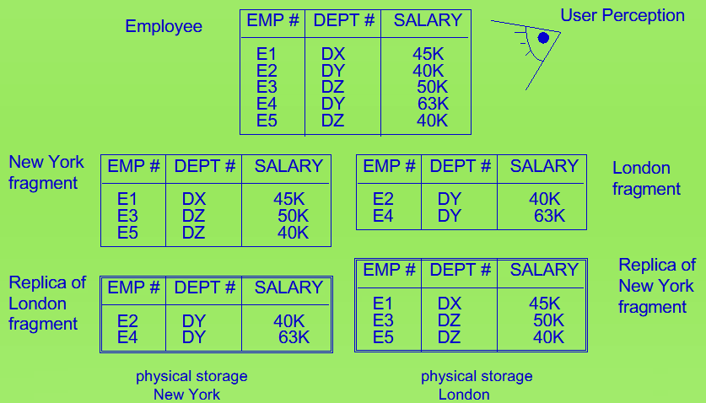
Rule 6 : Examples of Data Replication

Slide 43
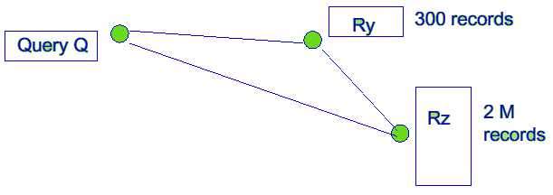
Rule 7 : Distributed Query Processing
Query processing in a distributed system involve
  local CPU and I/O activity at several distinct sites
  some amount of data communication among those sites
Amount of data communication is a major performance factor
Query compilation ahead of time
Views that span multiple sites
Integrity constraints within a DDBS that span multiple sites
It is crucially important for distributed database systems to choose a good strategy for distributed query processing

Slide 44
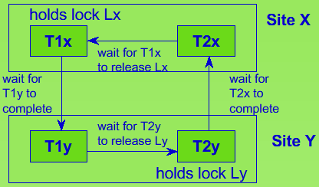
Rule 8 : Distributed Transaction Management
Two major aspects of transaction management, recovery control and concurrency control, require extended treatment in the distributed environment
In a distributed system, a single transaction can involve the execution of code at multiple sites and can thus involve updates at multiple sites
Each transaction is therefore
said to consist of multiple
“agents,” where an agent
is the process performed
on behalf of a given transaction
at a given site
Global deadlock: neither site
can detect it using only
information that is internal
to that site

Slide 45
Rule 9 : Hardware Independence
It is desirable to be able to run the same DBMS on different hardware systems
It is desirable to have those different hardware systems all participate as equal partners (where appropriate) in a distributed system
The strict homogeneity assumption is not relaxed; it is still assumed that the same DBMS is running on all those different hardware systems
User should be presented with the “single-system image” regardless any particular hardware platform

Slide 46
Rule 10 : Operating System Independence
From a commercial point of view, the most important operating system environments, and hence the ones that (at a minimum) the DBMS should support, are probably MVS/)(A, MVS/ESA, VM/CMS, VAX/VMS, UNIX (various flavors), OS/2, MS/DOS, Windows
It is obviously desirable, not only to be able to run the same DBMS on different hardware systems, but also to be able to run it on different operating systems - even different operating systems on the same hardware

Slide 47
Rule 11 : Network Independence
From the point of view of the distributed DBMS, the network is merely the provider of a reliable message transmission service
By “reliable” here is meant that, if the network accepts a message from site X for delivery to site Y, then it will eventually deliver that message to site Y;
Messages will not be garbled, will not be delivered more than once, and will be delivered in the order sent.
The network should also be responsible for site authentication
Ideally the system should support both local area networks and wide-area networks
Distributed system should support a variety of different network
architectures
It is obviously desirable to be able to support a variety of disparate communication networks

Slide 48
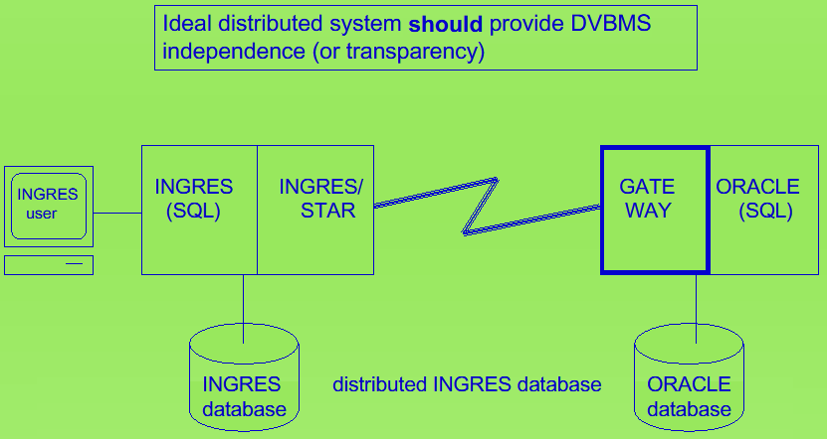
Rule 12 : DBMS Independence

Slide 49
Data Transparency
Data transparency: Degree to which system user may remain unaware of the details of how and where the data items are stored in a distributed system
Consider transparency issues in relation to:
  Fragmentation transparency
  Replication transparency
  Location transparency
Naming of Data Items - Criteria
  Every data item must have a system-wide unique name.
  It should be possible to find the location of data items efficiently.
  It should be possible to change the location of data items transparently.
  Each site should be able to create new data items autonomously.

Slide 50
Solution to Transparency Problem
Centralized Scheme – Name Server
  Structure:
    Name server assigns all names
    Each site maintains a record of local data items
    Site asks name server to locate non-local data items
Use of aliases
  Alternative to centralized scheme: each site prefixes its own site identifier to any name that it generates i.e., site 17.account.
    Fulfills having a unique identifier, and avoids problems associated with central control.
    However, fails to achieve network transparency.
  Solution: create a set of aliases for data items: Store the mapping of aliases to the real name at each sites
  The user can be unaware of the physical location of a data item, and is unaffected if the data item is moved from site to another

Slide 51
Distributed Transaction
Transaction may access data at several sites.
Each site has a local transaction manager responsible for:
  Maintaining a log for recovery purposes
  Participating in coordinating the concurrent execution of the transactions executing at that site.
Each site has a transaction coordinator, which is responsible for:
  Starting the execution of transactions that originate at the site.
  Distributing subtransactions at appropriate sites for execution.
  Coordinating the termination of each transaction that originates at the site, which may result in the transaction being committed at all sites or aborted at all sites.

Slide 52
System Failure Modes
Failures unique to distributed systems:
  Failure of a site.
  Loss of massages
    Handled by network transmission control protocols such as TCP-IP
  Failure of a communication link
    Handled by network protocols, by routing messages via alternative links
  Network partition
    A network is said to be partitioned when it has been split into two or more subsystems that lack any connection between them
      Note: a subsystem may consist of a single node
Network partitioning and site failures are generally indistinguishable.

